Slide 1
Using Rhetorical Appeals for Persuasive Writing
Dr. Jeff Dories
Goals:
Learn Rhetorical Appeals
Recognize Appeals in Advertisements
Recognize Appeals in writing
Question: How do we persuade other people to move towards our position?
As we wait: Choose an advertisement from the envelope that is effective and powerful

Slide 2
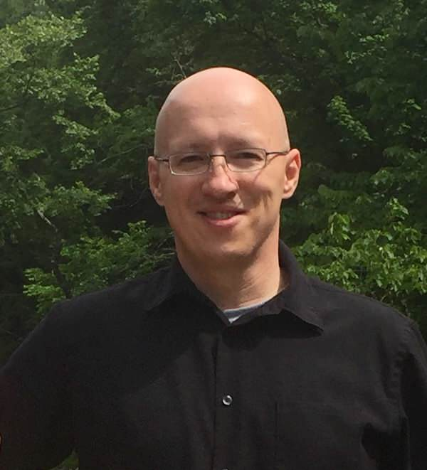



Ethos (Writer / Speaker)
Pathos (Audience)
Logos (Text / Speech)
The credibility, character, authority of the speaker
Connecting with the audience in an emotional manner
Logic of the argument A → B → C
Avoid hasty generalizations
Astrophysics for Experts
Jeff Dories, PhD
Rhetoric: To make visible and identify the means of persuasion.
Rhetorical Appeals: Using communication to modify the perspective of at least one other person.

Slide 3





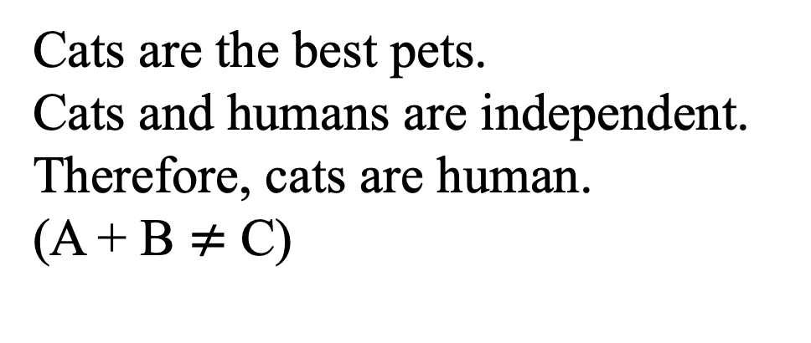
Socrates is human.
Humans are mortal.
Therefore, Socrates is mortal.
(A + B = C)
Cats are the best pets.
Cats and humans are independent.
Therefore, cats are human.
(A + B $≠$ C)

Slide 4


Astrophysics for Experts
Jeff Dories, PhD

Slide 5

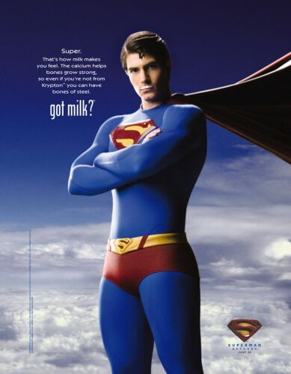

“Super: That’s how milk makes
you feel. The calcium helps bones
grow strong, so even if you’re not
from Krypton, you can have bones
of steel.

Slide 6



Slide 7
Pair and Share
Please share the ad that you chose with a partner. Use the handout to discuss what appeal(s) are used (Ethos, Pathos, Logos). Why is it effective?
Goals:
Examine rhetorical appeals
Learn some of the ways rhetorical appeals are used

Slide 8
Sample Introduction:
The current conflicts in the Middle East have caused increased awareness of the effects of Traumatic Brain Injury (TBI), Post-traumatic Stress Disorder (PTSD), and other “invisible wounds” (Jaffee and Meyer 1291). The term “invisible wounds” includes mental health conditions such as PTSD, depression, suicide, and TBI (Wieland, Hursey, and Delgado 4). It is important to study the impact of these “invisible wounds” in order to increase knowledge of PTSD and long-term trauma experiences and its effects on the mentality of civilians in a trauma-stricken area. By studying not only United States soldiers’ experiences with PTSD, but PTSD experienced by the Palestinian people as well, it will be easier to create a more varied approach of treating this disorder.
How is ethos (Authorial credibility) established here?

Slide 9
Sample Introduction:
The current conflicts in the Middle East have caused increased awareness of the effects of Traumatic Brain Injury (TBI), Post-traumatic Stress Disorder (PTSD), and other “invisible wounds” (Jaffee and Meyer 1291). The term “invisible wounds” includes mental health conditions such as PTSD, depression, suicide, and TBI (Wieland, Hursey, and Delgado 4). It is important to study the impact of these “invisible wounds” in order to increase knowledge of PTSD and long-term trauma experiences and its effects on the mentality of civilians in a trauma-stricken area. By studying not only United States soldiers’ experiences with PTSD, but PTSD experienced by the Palestinian people as well, it will be easier to create a more varied approach of treating this disorder.
How is ethos (Authorial credibility) established here?

Slide 10
Sample Introduction:
In 2009, American Evangelical Scott Lively headlined a conference in Uganda. His section of the conference was about the evils of the “gay agenda” (Foster and Simmons 45). Other American Evangelicals supported Lively, as well as, the Ugandan government’s endorsement of their infamous anti-sodomy laws. One month after the conference, which was presented to many people, including government officials, a new bill was introduced in Uganda. The Anti-Homosexuality Bill would make homosexual acts committed in Uganda crimes punishable by life in prison, and in some cases, death (48). These radical ideas contradict the predominant Christian value of “love thy neighbor” and should be denounced by Christians both in Uganda and the United States.
How is pathos (emotional connection to audience) established here?

Slide 11
Sample Introduction:
In 2009, American Evangelical Scott Lively headlined a conference in Uganda. His section of the conference was about the evils of the “gay agenda” (Foster and Simmons 45). Other American Evangelicals supported Lively, as well as, the Ugandan government’s endorsement of their infamous anti-sodomy laws. One month after the conference, which was presented to many people, including government officials, a new bill was introduced in Uganda. The Anti-Homosexuality Bill would make homosexual acts committed in Uganda crimes punishable by life in prison, and in some cases, death (48). These radical ideas contradict the predominant Christian value of “love thy neighbor” and should be denounced by Christians both in Uganda and the United States.
How is pathos (emotional connection to audience) established here?

Slide 12
Sample Introduction:
The United States and India need to be more aware of human trafficking and have better laws that protect the victims. Currently, it seems like both countries support human trafficking because of their indifference to the topic. Human trafficking is a more prevalent problem than people think. Unfortunately, even if people were made aware, they probably would not do anything about it. Victims of trafficking are often deceived or forced into being trafficked. In order to stop this, students in India and the United States need to write their leaders in protest.
Is logos used correctly here? (Text / Logic: if A → then B → then C / Avoiding hasty generalizations)

Slide 13
Sample Introduction:
The United States and India need to be more aware of human trafficking and have better laws that protect the victims. Currently, it seems like both countries support human trafficking because of their indifference to the topic. Human trafficking is a more prevalent problem than people think. Unfortunately, even if people were made aware, they probably would not do anything about it. Victims of trafficking are often deceived or forced into being trafficked. In order to stop this, students in India and the United States need to write their leaders in protest.
Is logos used correctly here? (Text / Logic: if A → then B → then C / Avoiding hasty generalizations)

Slide 14
Questions:
What is the primary goal of persuasive writing?
Why is it important to understand rhetorical appeals?
What is an effective way to add ethos to your paper?
How should you use pathos in a formal research paper?

Slide 15

Thank You!
Dr. Jeff Dories
Phone: TBA
E-mail: TBA
Questions?

